Slide 1
Training GANs with Keras and Pytorch
Volodymyr Liunda and Jacob Ekstrum

Slide 2
Key Topics
Framework comparison
Introduction to PyTorch and Google Colab
Introduction to Keras (Functional Interface)
Data Loaders, Layers, and Loss Functions
Example - Cats and Dogs GAN
Leveraging GPU Resources
Using Google Cloud Platform (Demo)
Using your own GPU
Best Practices for Training GANs
(Time Permitting) Setup Individual GCP Environments

Slide 3
Key Topics
Framework comparison
Introduction to PyTorch and Google Colab
Introduction to Keras (Functional Interface)
Data Loaders, Layers, and Loss Functions
Example - Cats and Dogs GAN
Leveraging GPU Resources
Using Google Cloud Platform (Demo)
Using your own GPU
Best Practices for Training GANs
(Time Permitting) Setup Individual GCP Environments

Slide 4
Framework comparison
Keras
Pros:
Easy to develop prototypes
Leverages vast Tensorflow infrastructure
TFLite
TensorFlow Extended (TFX)
Full Tensorboard support
Cons:
Less expressive
Eager execution in beta
Harder to debug
PyTorch
Pros:
Expressivity
Eager execution
Easy inspectability
Built-in ONNX support
Cons:
Partial support of Tensorboard
Needs to be converted for production
More boilerplate code

Slide 5

Intro to
PyTorch

Slide 6
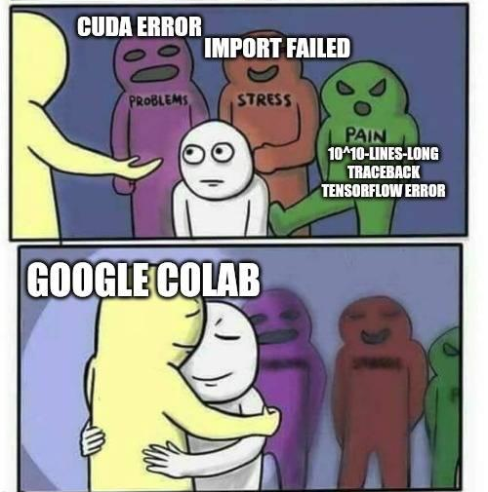
Introduction to PyTorch
ref: PyTorch docs
code: Google Colab

Slide 7
Key Topics
Framework comparison
Introduction to PyTorch and Google Colab
Introduction to Keras (Functional Interface)
Data Loaders, Layers, and Loss Functions
Example - Cats and Dogs GAN
Leveraging GPU Resources
Using Google Cloud Platform (Demo)
Using your own GPU
Best Practices for Training GANs
(Time Permitting) Setup Individual GCP Environments

Slide 8

Intro to Keras

Slide 9
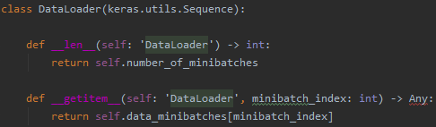
Introduction to Keras - Data Loaders
Data can be fed to models through:
Arrays or Feed Dictionaries (Fast to Write)
Python Generators (Simple)
Data Loader Classes (Stable)
Data loader classes extend Keras Sequential classes
Thread-safe
Object-oriented
Intuitive
Notes:
Data loaders allow for online preprocessing like generators, but can be more legible.
Functions can be packed into the class and reused.
Inheritance of data loaders can be exploited.

Slide 10
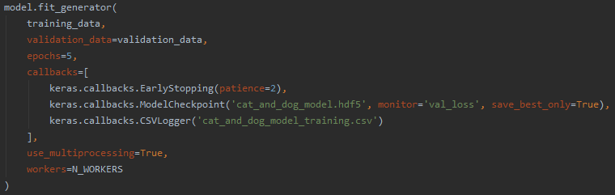
Introduction to Keras - Data Loaders
Methods like on_epoch_end and on_batch_end remove boilerplate code
Easy to shuffle data
Easy to prepare batches for, e.g., hard negative mining
Standard models can easily train with model.fit_generator
More complex models can write their own training routines

Slide 11
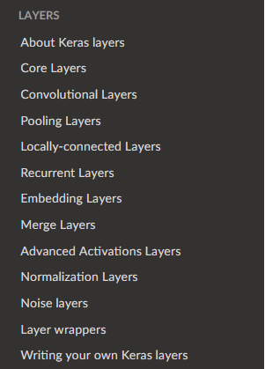
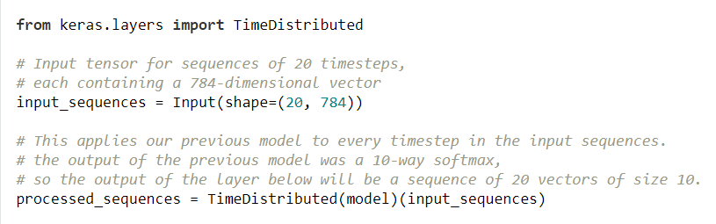
Introduction to Keras - Layers
https://keras.io/layers/about-keras-layers/
There are a lot of pre-built layers
Custom layers are possible, if needed
Most can be handled by a Lambda layer
Keras Models inherit from the Layer class
Users can intermix models and layers when constructing new models
Code source: https://keras.io/getting-started/functional-api-guide/

Slide 12
Introduction to Keras - Layers
Examples of commonly used Layers (keras.layers.<layer name>)
Input
Dense
Activation
ReLU, Activation(“sigmoid”), …
Conv2D
Conv2DTranspose
MaxPooling2D
AveragePooling2D, Upsampling2D, …
Add, Concatenate
Embedding
BatchNormalization
LSTM (CuDNNLSTM), GRU (CuDNNGRU)
TimeDistributed
Lambda

Slide 13
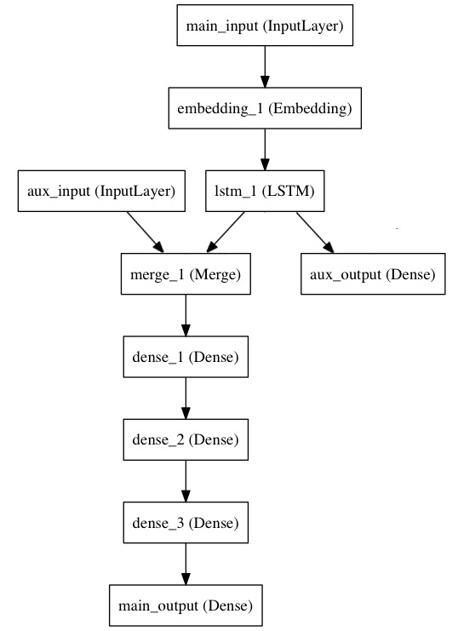
Introduction to Keras - Layer Tips
All Sequential models can be represented as Functional models
Not all Functional models can be represented as Sequential models
Avoid Lambda layers
Lambda layers are slow
There are many existing layers that can accomplish your goal
Exceptions exist
Core sampling layers are turned off at inference time
Layers can be tweaked through keyword arguments
Regularization (kernel, bias, and activity)
In-line activation
Model structure: https://keras.io/getting-started/functional-api-guide/

Slide 14
Introduction to Keras - Custom Loss Functions
Keras models must be compiled before use
Requires an optimizer
Requires a loss function
Keras has good optimizer support
https://keras.io/optimizers/
Standard optimizers often work well
Choice of hyperparameters and loss function are typically more important
Most standard objective functions can be improved upon
I.E., Wasserstein GANs (https://arxiv.org/pdf/1701.07875.pdf)
Keras allows for custom loss functions
Must take a true value tensor and a predicted value tensor as input
Must produce a loss value for the minibatch as output

Slide 15

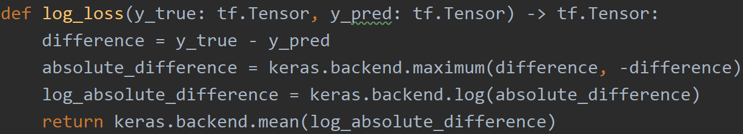
Introduction to Keras - Custom Loss Functions
Which line could be buggy?
(or, lines)

Slide 16
Introduction to Keras - Custom Loss Functions
Which line could be buggy?
(or, lines)

Slide 17
Introduction to Keras - Custom Loss Functions
The Keras backend library is “safe”
Fewer functions are available
All functions will automatically port to different backends
By restricting portability, TensorFlow functions can be used as well
Order of (personal) preference:
Layers and Standard loss functions
User-defined with Keras backend functions
User-defined with one backend’s functionality
https://keras.io/backend

Slide 18
Example Walkthrough:
Keras Simple GAN

Slide 19
Key Topics
Framework comparison
Introduction to PyTorch and Google Colab
Introduction to Keras (Functional Interface)
Data Loaders, Layers, and Loss Functions
Example - Cats and Dogs GAN
Leveraging GPU Resources
Using Google Cloud Platform (Demo)
Using your own GPU
Best Practices for Training GANs
(Time Permitting) Setup Individual GCP Environments

Slide 20
Leveraging GPUs via GCP
Google Cloud Platform gives a trial subscription
The subscription runs out after $300 or one year
Leveraging the platform is less straightforward than Colab
However, it is a great option if Colab jobs are timing out
Steps:
Install Cloud SDK
(Re)configure your development environment
Port data binaries to the Cloud
Modify code to leverage data binaries and command-line arguments
Push code to GCP through Cloud Shell

Slide 21
GCP - Installation and Configuration
Create a Cloud Project
Enter Google Cloud and Click “New Project” in the Upper-Left
Create a Cloud Storage Bucket
Enable Cloud ML and Compute Engine components for your project
https://console.cloud.google.com/flows/enableapi?apiid=ml.googleapis.com,compute_component
Installation - from the documentation (https://cloud.google.com/sdk/docs/):
Download the Cloud SDK installer
Launch the installer and initialize gcloud
gcloud init

Slide 22
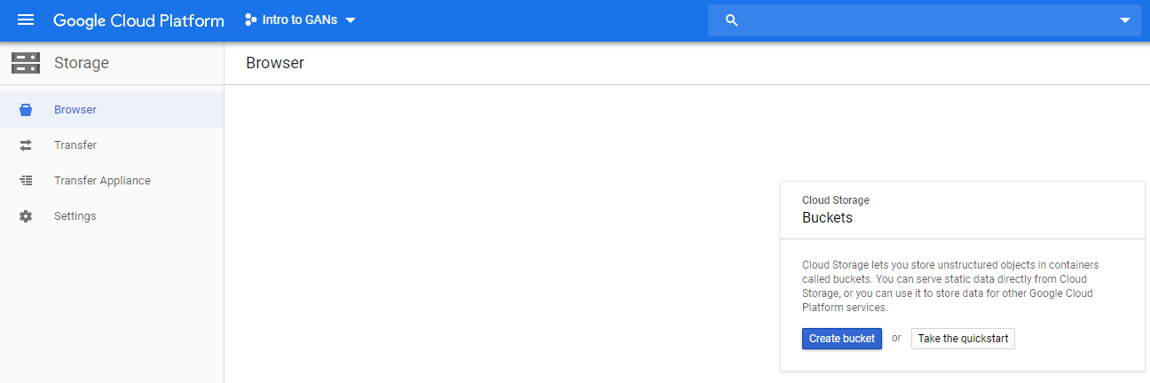
GCP - Creating a Cloud Storage Bucket

Slide 23
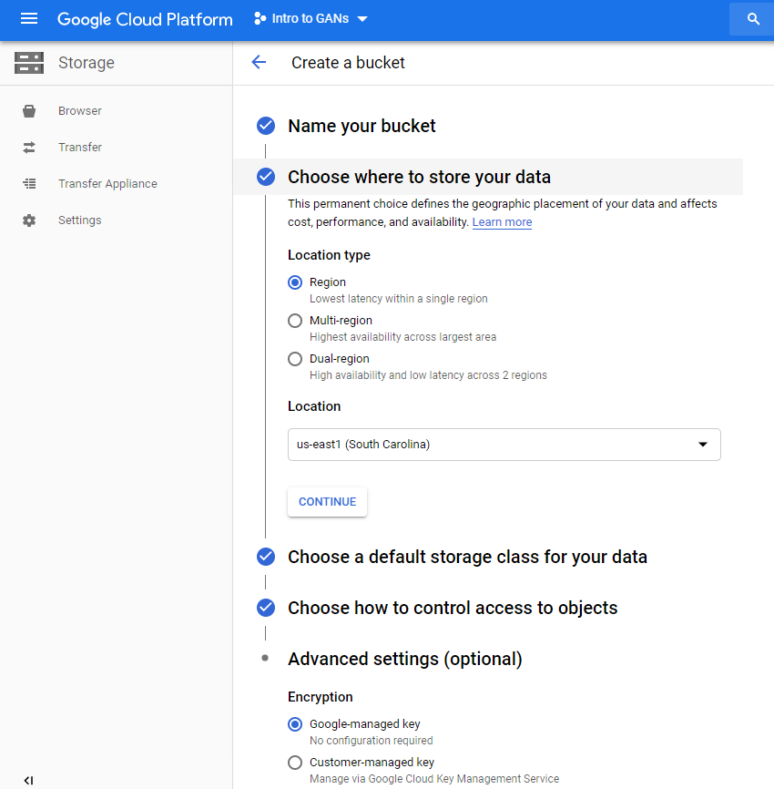
GCP - Creating a Cloud Storage Bucket

Slide 24
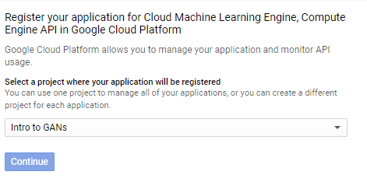
GCP - Enabling Cloud ML and Compute Engine
https://console.cloud.google.com/flows/enableapi?apiid=ml.googleapis.com,compute_component

Slide 25
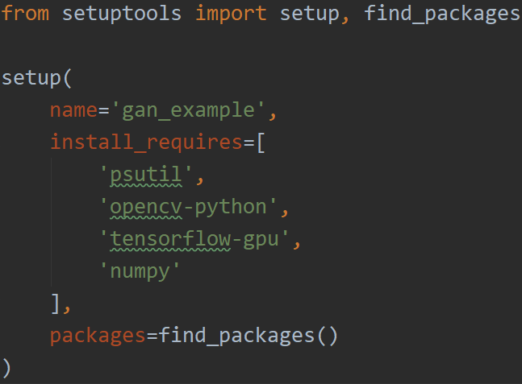
GCP - Porting Data Binaries
First, package your data files in a convenient way
Zip, Pickle, BZip2, etc.
Leverage gsutil to copy data files to your bucket
gsutil cp [-r] <data-files> gs://<your-bucket>/path/to/folder
Update your code to ensure that files are unpacked/parsed properly
Python packages: zipfile, bz2, pickle
Copy files from the cloud bucket to the local filesystem
RAM: Copy to /tmp/<path>
Will be cleared upon application termination
Local disk: Documentation is contradictory
Update setup.py script to include required packages
Update model checkpoint logic to store checkpoints in the cloud

Slide 26
GCP - Executing Training Jobs
Execute the training command from the shell
gcloud ai-platform jobs submit training <job-name> [args]
Helpful flags include:
--python-version 3.5
--scale-tier BASIC_GPU
--job-dir gs://<my-bucket>/path/to/working/directory/
--runtime-version 1.14
--module-name <training-package-name>.<training-file-name>
--package-path <training-code-root-directory>
--region <bucket-region>
-- [user-args]
View logs, debug, rinse, and repeat
gcloud ai-platform jobs stream-logs <job-name>
Stackdriver logging

Slide 27
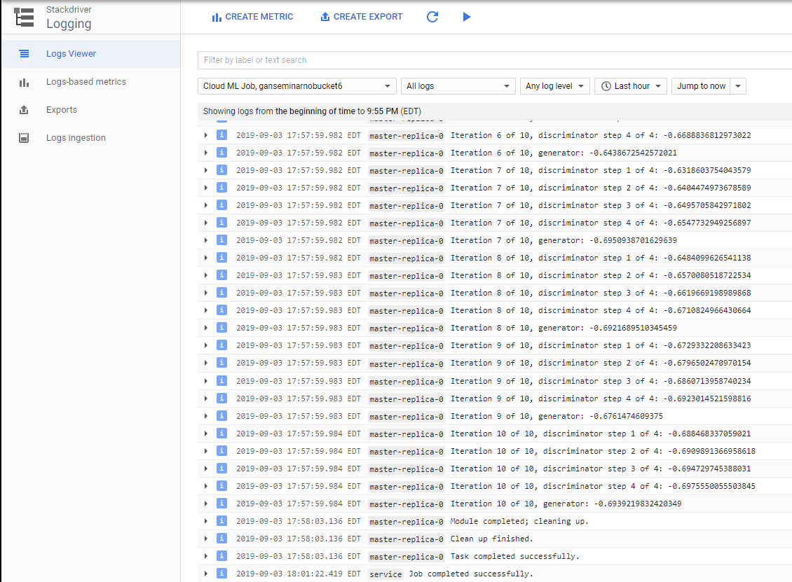
GCP - Stackdriver Logging

Slide 28
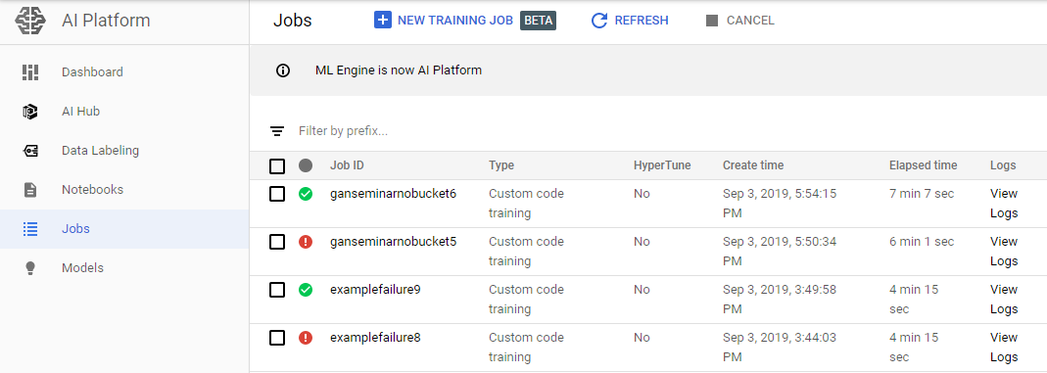
GCP - Job Viewer

Slide 29
GCP - Summary
GCP is highly configurable
GCP can be extremely confusing
Use GCP if you need access to powerful machines with multiple GPUs
Don’t use GCP to train an MNIST model
Alternatives to GCP
Google Colab
Try out the new GCP AI Platform Notebooks (2019)
Jupyter (locally, with GPUs)

Slide 30
Leveraging GPUs via GCP - Further Resources
Accessing GCP
Installing Cloud SDK
Creating a training application
Submitting a training job
Viewing training jobs
Using Multiple GPUs
Google Cloud Documentation has multiple examples on leveraging the AI platform, including samples
More examples and resources are on Medium, Towards Data Science, etc.

Slide 31
Demonstration:
Training a Keras Model on Google Cloud

Slide 32

Utilizing your own GPU
Installation procedure:
https://www.tensorflow.org/install/gpu
Works for Keras
Very few tweaks needed for PyTorch
Install CUDA drivers
Install CuDNN scripts
Requires NVIDIA Developer account
Install GPU versions of your preferred ML Toolkit
Code changes
For Keras - None!
*keras.utils.multi_gpu_model(model)
For PyTorch - just send elements to device

Slide 33
Key Topics
Framework comparison
Introduction to PyTorch and Google Colab
Introduction to Keras (Functional Interface)
Data Loaders, Layers, and Loss Functions
Example - Cats and Dogs GAN
Leveraging GPU Resources
Using Google Cloud Platform (Demo)
Using your own GPU
Best Practices for Training GANs
(Time Permitting) Setup Individual GCP Environments

Slide 34
Training tips
Never forget to normalize outputs
Add noise to both labels and inputs
Avoid sparse gradients (ReLU → LeakyReLU, MaxPool → AvgPool)
Use Adam optimizer with small learning rates (like 1e-4 small)
Use BatchNorm in Generator, but not Discriminator
Discriminator should be roughly as expressive as the generator
Check out this repo for more

Slide 35
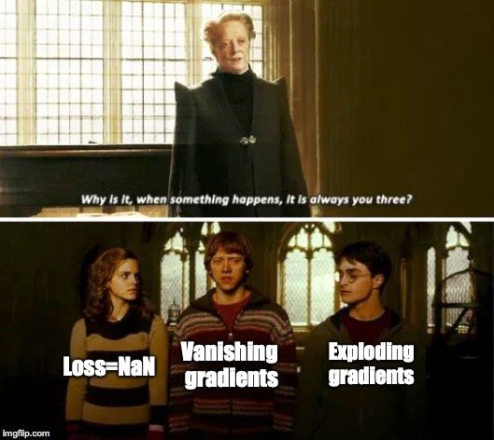
Early signs of failure
D or G losses go down steadily
D loss has large variance
Gradient explosion
Check out this repo for more

Slide 36
Key Topics
Framework comparison
Introduction to PyTorch and Google Colab
Introduction to Keras (Functional Interface)
Data Loaders, Layers, and Loss Functions
Example - Cats and Dogs GAN
Leveraging GPU Resources
Using Google Cloud Platform (Demo)
Using your own GPU
Best Practices for Training GANs
(Time Permitting) Setup Individual GCP Environments

Slide 37
Thank you

